Slide 1
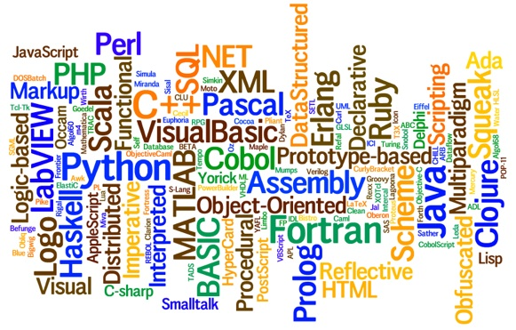
CS-445 Programming Languages Slides 5 – Factors affecting Language Design
By Talha Waheed, UET Lahore

Slide 2
Course Learning Objective

Slide 3
Language Definition
Different users have different needs:
programmers
tutorials, reference manuals, programming guides (idioms)
implementors
precise operational semantics
verifiers
rigorous axiomatic or natural semantics
language designers and language advocates
all of the above
Different levels of detail and precision
But none of them can be sloppy!

Slide 4
Language Design Perspectives
Software developers ask for more features.
Theoreticians ask for features with clean semantics.
Developers of mission-critical software want features that are easier to verify formally.
Compiler writers want features that are orthogonal, so that their implementation is modular.
These goals are often in conflict

Slide 5
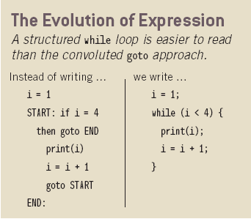
Factors Influencing Language Design
The language we "speak" influences what we can say
[Whorf]
Application programmers' perspective
Make programming as easy and natural as possible
Define a user-friendly "virtual machine“
Language implementers' perspective
Make efficient implementation possible
Define a reasonable mapping to a real machine

Slide 6
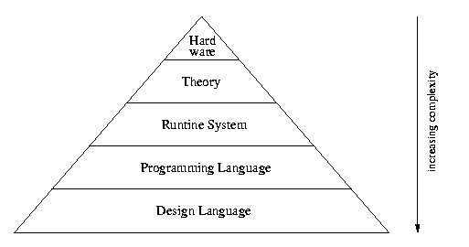
Factors Influencing Language Design
Hardware Architecture
Application Domains
New uses and users, Changing requirements
Programming methodologies
Managing large, complex systems
Implementation methods
Improved techniques
Theoretical studies
Assess strengths and weaknesses
Standardization (formal or de facto)
Portability & Re-use
Strong promoter (usually an organization)
Easy access to high quality compilers and tools
Hardware
Applications
Programming Languages
Systems Software
Theory

Slide 7
Influence of computer architecture on language design
We use imperative languages because of the von Neumann Architecture
Lisp machine – designed and built at MIT
Parallel languages – designed to exploit parallelism in the architecture

Slide 8
Impact of Machine Architecture
In developing Programming Languages, the architecture of the software influences the design of a language in two ways:
1) underlying computer on which program written will execute
2) execution model or virtual computer that supports the language on actual hardware

Slide 9
The Operation of a Computer
What is a Computer?
an integrated set of Algorithms and data structure capable of storing and executing programs
a hardware device using wires, ICs etc
software simulated computer (programs running on another computer)
Implementation of Programming Language
Translator converts program into Machine language that can be executed by some computer.
Notes:
The computer that executes the translated programs may either be a H/W or a virtual Computer

Slide 10
Computer Hardware
Data
Primitive Operations
Sequence Control
Data Access
Storage Management
Operating Environment
Notes:
A computer consists of 6 major components that corresponds closely to the major aspects of a programming Language

Slide 11
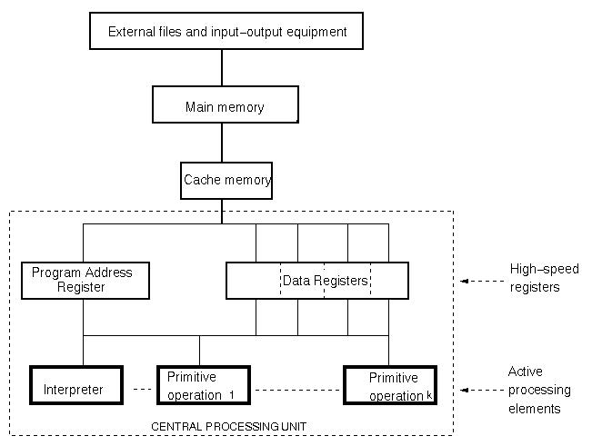
Organization of a conventional computer

Slide 12
Data
organization of main memory
High speed registers
contents of register may represent data or address in main memory containing the data or next instructions
cache memory is for high speed data access
External files are subdivided into records, each of which is a sequence of bits.
Built in data types that can be manipulated directly by H/W operations
programs are also form of data
machine language
Notes:
In fig. 3 data storage components Main memory, high speed registers and external files
Main memory is organized as a linear sequence of bits (typically 32 or 64 bits)
High speed registers consists of word length bit sequences and may have special fields that are directly accessible
ML program would be structured as a sequence of memory locations each containing instructions.
Each instruction is composed of an op-code and a set of operands

Slide 13
Operations
built in operations
1-1 correspondence with Machine Language
arithmetic operations for each numeric data type
operations for testing - (zero, -ve, +ve)
operations for access/modification (get/store in a word)
operations for controlling I/O devices
operations for sequence control (jumps, returns)
CISC vs. RISC

Slide 14
Sequence Control
next instruction to be execute in program address register (IP)
set of operations for modification of program address register
interpreter uses the IP and guides the sequence of operations
interpreter gets next address, fetches instruction from memory, decodes into op-code and operands and execute

Slide 15
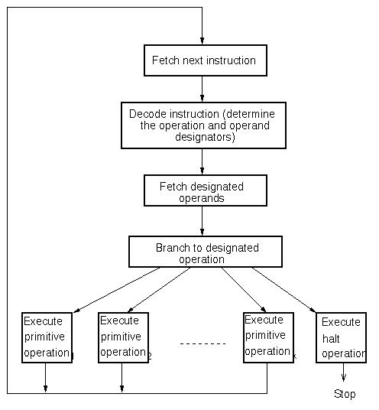
Program interpretation and execution

Slide 16
Data Access
Operands - main memory or register
retrieval and storage operations
conventional scheme - integer address
Storage Management
speed of main memory vs. external data
multiprogramming
paging, dynamic program relocation
cache - for high speed access

Slide 17
Operating Environment
storage and I/O devices
different operations for each class of device
Different Computer Architectures
von Neumann
Multi processors
distributed computers
Computer States
Initial state, state transition, final state
Notes:
Von neumann architecture: small CPU, consisting of primitive operations sequence control and registers for results, a larger main memory, process for retrieving/storing data between CPU and memory.
Most computers use this basic design although additions like cache, more registers, and virtual memory improved speeds
Imbalance between CPU and external media
Multiple inexpensive CPUs
Some languages have instructions for multiprocessors. Like co-routine etc.
Static organization in terms of data, operations, sequence control vs. dynamic operations What operations executed in what sequence?
Program execution may be seen as sequence of state transition made by computer.

Slide 18
Firmware Computers
Machine Language not restricted to low level, any language that specify data structure and algorithms can be used like C, Ada. But it is more complex and costly and less flexible.
Any precisely defined algo or data structure can be realized in hardware
Alternative to strict H/W realization is firmware computer simulated by microprogrammable H/W computer. Micro prgram resides in ROM, executes at high speed
Microprogram simulation is called emulation. ( resulting computer is virtual computer. Without this microprogram simulation machine would not exist)
Notes:
To construct a H/W device whose machine language is precisely that of the defined computer.

Slide 19
Translation
Converting a program written in a HLL into machine language.
Compilation: whole program is translated before execution. (C/C++)
Interpretation: Translate and execute, one statement at a time. (BASIC)
Source Code
Source Code
Input
Output
Compiler
Interpreter
Input
Target Code
Output
Notes:
interpreters run program
translator (compilers) transform programs from one form to another
the CPU is a hardware interpreter; it actually does something
hybrid systems: compile to byte-code, interpret byte-code

Slide 20
Comparison of the two methods
Compilation
Brings the program down to machine level
Can execute translated program many times because the entire translation is produced.
Program execution is much faster because the translator can do optimization.
Harder to provide feedback when debugging because executing the target code.
Interpretation
Brings the machine up to the program level.
Must re­translate for every execution.
Program execution is much slower.
Easier to provide feedback when debugging because executing the source code.

Slide 21
Pseudo­compilation
A hybrid of compilation and interpretation
Source Code
Compiler
Intermediate Code
Input
Output
Interpreter

Slide 22
Pseudo­-compilation
A compiler translates the whole program before execution, but only into intermediate code.
An interpreter translates and executes the intermediate code one statement at a time.
The intermediate code can be executed on any machine that has an interpreter for the intermediate code.
more portability and machine independence
Java initially used this hybrid strategy. (intermediate code: bytecode)

Slide 23
Translators and Virtual Architectures
Translation (Compilation)
assembler, compiler, loader(creates single exe file), macroprocessor
Software Simulation (Interpretation)
A computer whose machine language is HLL
Simulated computer accepts as Input data a program in HLL and produces output as another HLL
Host computer creates a virtual machine simulating HLL
Notes:
Translation of HLL involves many steps like , C++ program translated into C, then compiled into assembly, assembled to produce relocatable machine code and finally linked and loaded to produce exe code
When host computer is executing HLL it is not possible to tell whether the program is executed directly by H/W or first converted to ML

Slide 24
Simulation Vs. Translation
Translator converts input program into object language - simulator executes directly
Translator process in physical input sequence - simulator follows logical flow
Pure translation and simulation are 2 extremes

Slide 25
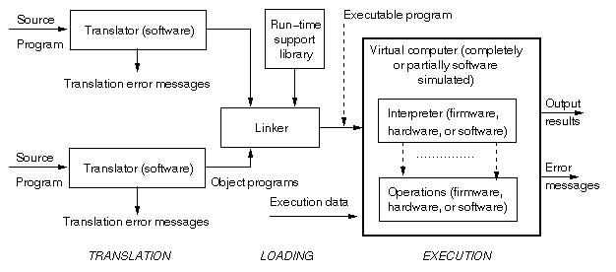
Structure of a typical language implementation

